Slide 1
Introduction to Quantum Computing
Dr. Thyagaraju G S
Professor and HoD, Department of CSE,
SDM Institute Of Technology, Ujire-574240

Slide 2
Topics :
Introduction to Quantum Computing
Why Quantum Computing?
What is Quantum Computing ?
Fundamental Principles of Quantum Computing
Qubits
Introduction to Python Qiskit
Quantum Gates and Quantum Circuits
Introduction to Quantum Algorithms
Future Directions and Research Opportunities

Slide 3
1.0 Why Quantum Computing?

Slide 4
1.1 Primary reasons
Enhanced Problem-Solving/Computing Capabilities
Solving complex problems that involve numerous variables and uncertainties
Exponential Scaling
Power of quantum computers increases exponentially with the addition of qubits
Energy Efficiency
Lower energy consumption and reduced carbon emissions
Communication
Provide better security and improved long-distance communications,
Sensing
Extremely precise measurements

Slide 5
1.2 Primary Applications
Chemistry and Materials Science
Aiding in drug discovery and materials development
Logistics and Optimization
Optimize logistics and route planning
Cryptography
Quantum-resistant algorithms, secure communication networks using quantum key distribution (QKD)
4. Artificial Intelligence
Handling complex datasets and Models
5. Weather Forecasting and Climate Change/Disaster Management
by simulating complex atmospheric and oceanic systems more accurately

Slide 6
3.0 What is Quantum Computing ?

Slide 7
3.1 What is Quantum ?
The term "quantum” (plural: quanta) originates from the Latin word for "how much.“
Quantum refers to the smallest possible discrete unit of any physical property, usually related to energy and matter.
Example :
A quantum of light is a photon, and
A quantum of electricity is an electron
Quantum Particles
Fermions (Particles that make up matter): Electrons , Protons , Neutrons, Quarks, Neutrinos
Bosons (Force-carrying particles): Photons, Gluons, W and Z Bosons, Higgs Boson, Gravitons (Theoretical)
Composite Particles: Mesons, Baryons

Slide 8
3.2 What is Quantum Computing?
Quantum computing is a type of computing that leverages the principles of quantum mechanics to process the information.
Quantum mechanics is the theory that describes the behavior of microscopic systems, such as photons, electrons, atoms, molecules, etc.

Slide 9
Principles of Quantum Mechanics (Unique Characteristics of Quantum Particles)
Wave-Particle Duality
Superposition
Entanglement
Quantization
Uncertainty Principle
Probability and Wave functions

Slide 10
4.0 Fundamental Principles of Quantum Computing
4.1 Qubits
4.2 Superposition
4.3 Entanglement
4.4 Quantum Interference
4.5 Decoherence
4.6 Quantum Tunneling
4.7 Measurement and Collapse

Slide 11
4 Core Components of Quantum Computer
A quantum computer is a device that exploits quantum mechanical phenomena, such as superposition and entanglement, to perform computations.
Qubits
Quantum Registers
Quantum Gates
Quantum Circuits
Quantum Processing Unit (QPU)
Measurement Devices

Slide 12
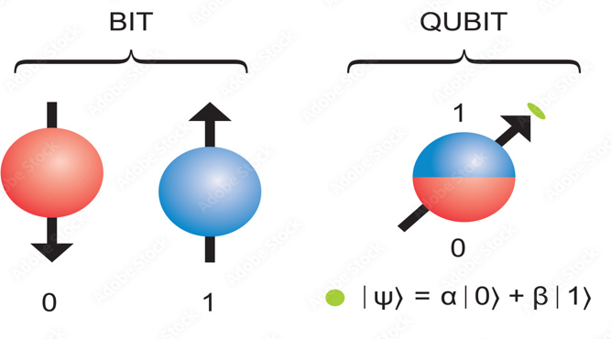
1. What is a Qubit?
A qubit, or quantum bit, is the fundamental unit of information in quantum computing, analogous to a classical bit in traditional computing.

Slide 13
Key Characteristics of Qubits
Superposition: A qubit can exist in a superposition of both states simultaneously. This means that a qubit can represent 0, 1, or any combination of the two at the same time.
Mathematically, a qubit can be expressed as:∣ψ⟩=α∣0⟩+β∣1⟩
where α and β are complex numbers representing the probability amplitudes of the qubit being in state |0⟩ or |1⟩, respectively.
Entanglement: Qubits can be entangled, meaning the state of one qubit is directly related to the state of another, regardless of the distance separating them.
Measurement: When a qubit is measured, it collapses from its superposition state to one of the basis states (either |0⟩ or |1⟩). The outcome of the measurement is probabilistic.

Slide 14
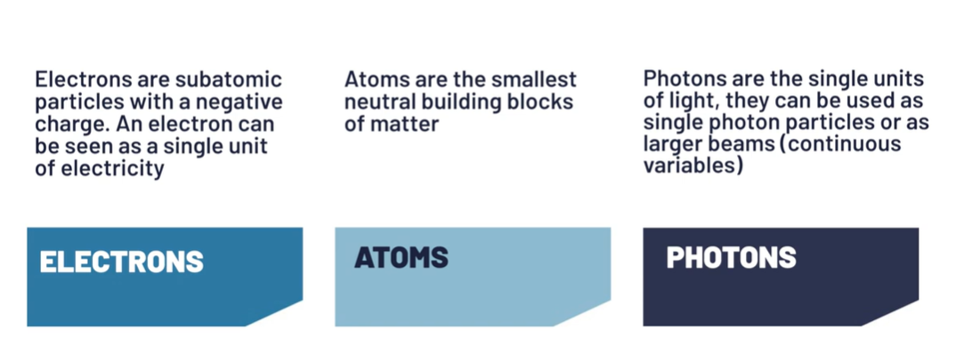
Type of particles used to build Qubits

Slide 15
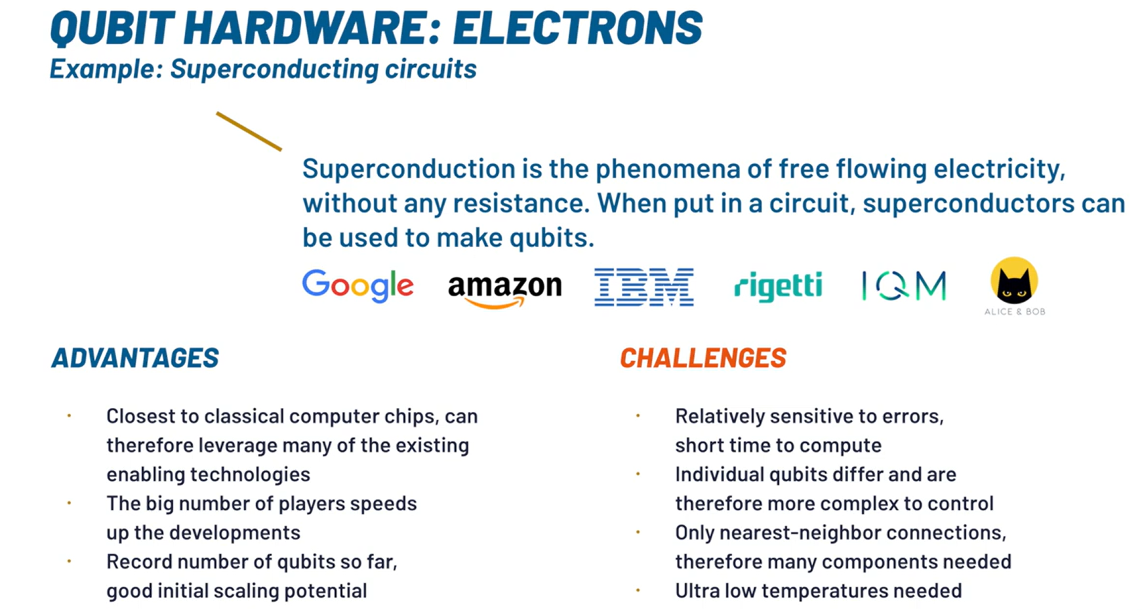
Superconducting qubits: IBM creates transmon qubits using niobium and aluminium on a silicon substrate
Source: Quantum Computing Hardware - An Introduction (youtube.com)

Slide 16
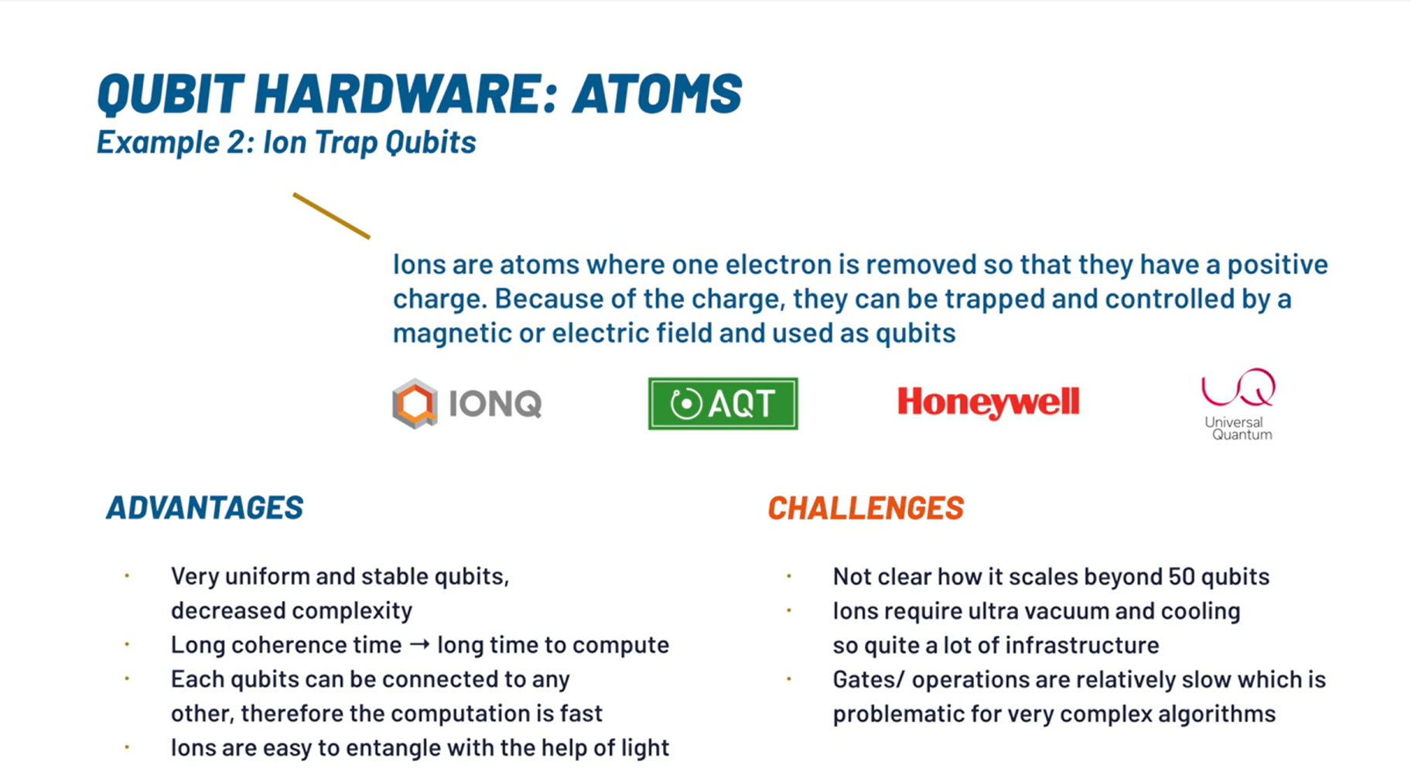
Source: Quantum Computing Hardware - An Introduction (youtube.com)
Trapped –ion qubits: Quantinuum and IonQ create qubits using ionized ytterbium atoms

Slide 17
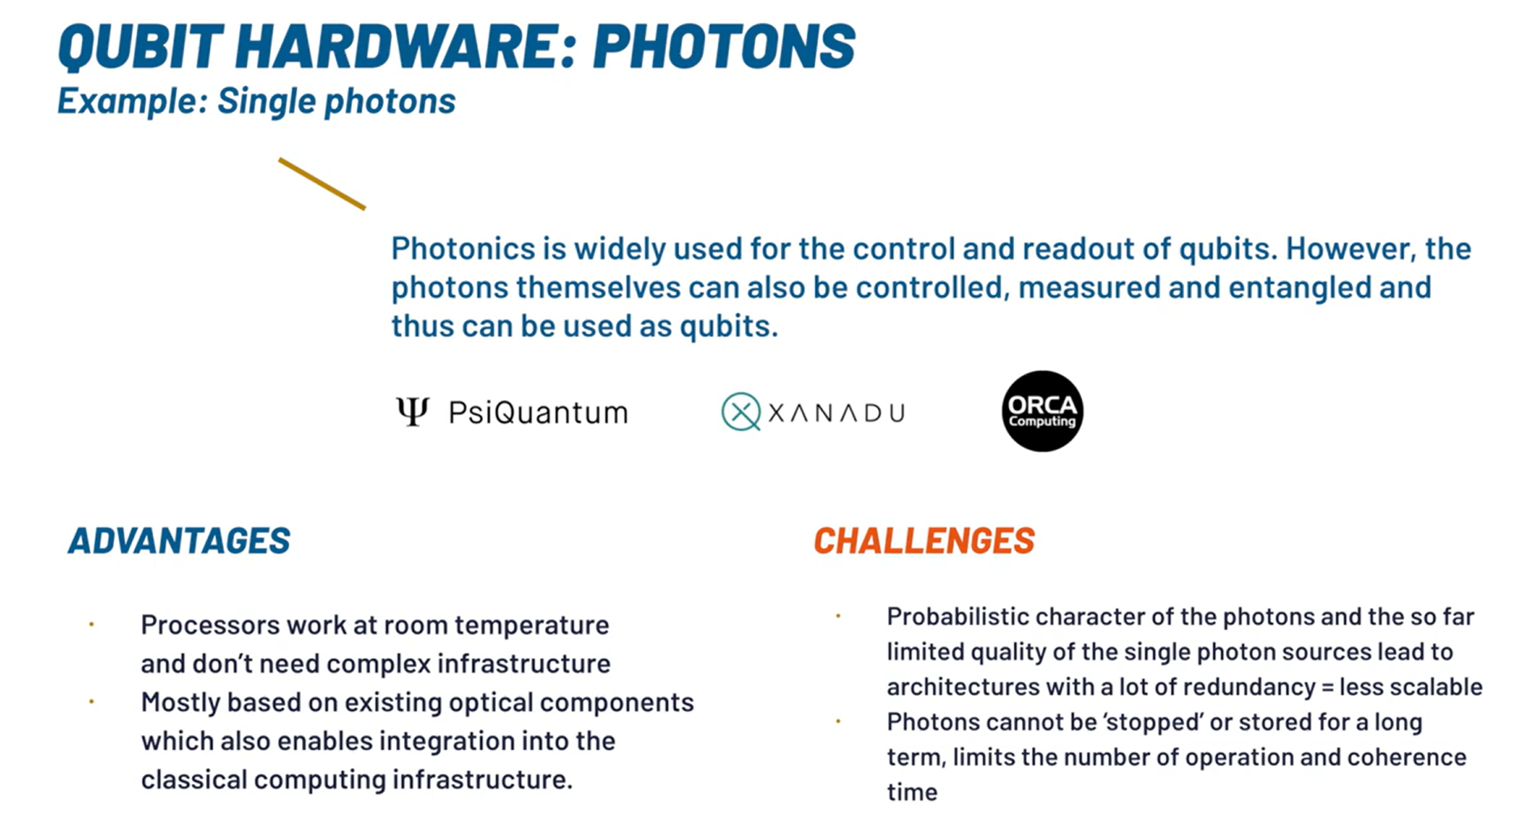
Source: Quantum Computing Hardware - An Introduction (youtube.com)
Xanadu creates qubits by squeezing laser light using ring resonators

Slide 18
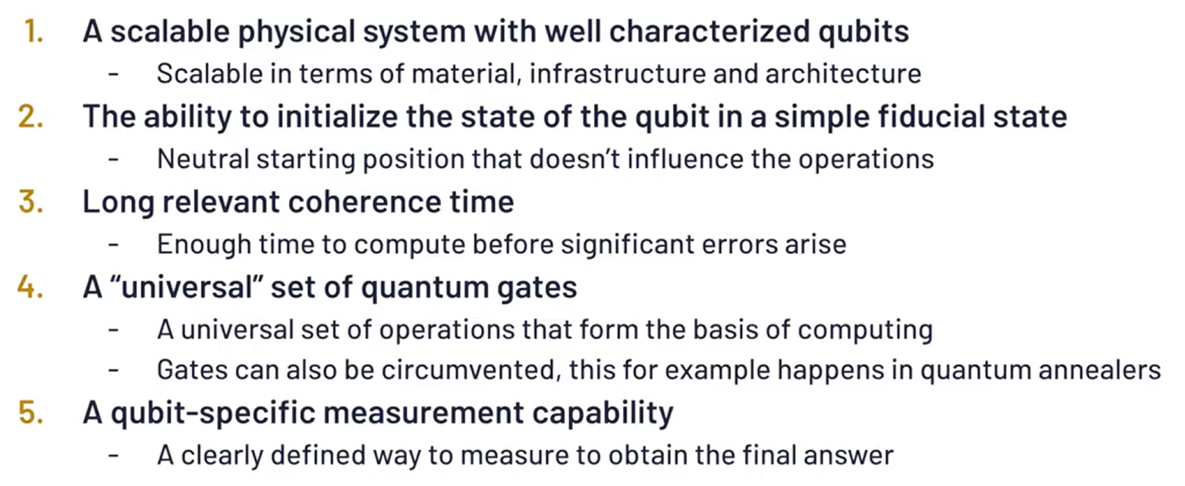
QC Hardware : Basic Requirements

Slide 19
Year | Qubit Size | Milestone
1998 | 9 | First demonstration of quantum error correction using 9 physical qubits to encode 1 logical qubit.
2016 | 5 | IBM introduces the 5-qubit IBM Q 5 Tenerife and IBM Q 5 Yorktown processors.
2017 | 14 | IBM launches the 14-qubit IBM Q 14 Melbourne processor.
 | 16 | IBM introduces the 16-qubit IBM Q 16 Rüschlikon processor.
 | 17 | IBM unveils the 17-qubit IBM Q 17 processor.
 | 20 | IBM releases the 20-qubit IBM Q 20 Tokyo processor.
2018 | 20 | IBM releases the 20-qubit IBM Q 20 Austin processor.
 | 50 | IBM introduces the 50-qubit IBM Q 50 Prototype.
2019 | 53 | IBM launches the 53-qubit IBM Q 53 processor.
 | 53 | Google claims quantum supremacy with its 53-qubit Sycamore processor.
2020 | 27 | IBM achieves a Quantum Volume of 64 with a 27-qubit processor.
2021 | 127 | IBM releases the 127-qubit IBM Quantum Eagle processor.
2022 | 433 | IBM unveils the 433-qubit IBM Quantum Osprey processor.
2023 | 1,121 | IBM presents the 1,121-qubit IBM Quantum Condor processor.
 | 1,305 | Researchers at TU Darmstadt demonstrate a 1,305-qubit array based on optical tweezers.
 | 1,180 | Atom Computing announces a 1,180-qubit array based on Rydberg atoms.
2024 | Up to 8 | Researchers fuse small quantum states into states with up to eight qubits.

Slide 20
Challenges and Considerations
Decoherence: Quantum systems are sensitive to their environment, and maintaining coherence is critical for reliable computations.
Error Correction: Quantum computations are prone to errors, necessitating the development of quantum error correction codes and fault-tolerant techniques.
Scalability: As quantum computers grow in size and complexity, challenges related to maintaining qubit coherence and reducing noise become increasingly significant.

Slide 21
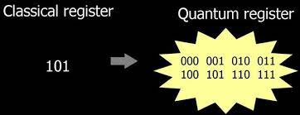
2. Quantum Register
A quantum register is a system comprising multiple qubits, serving as the quantum analogue of the classical processor register.
Source: Google Images

Slide 22
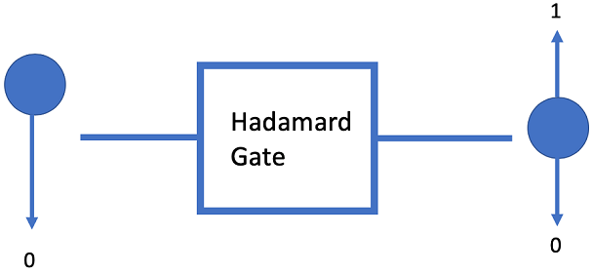
3. Quantum Gates
Quantum gates is a mathematical operation that acts on the state of one or more qubits, and it can be represented by a matrix.

Slide 23
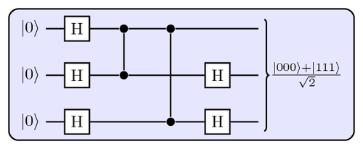
4. Quantum Circuits
Quantum circuits are composed of quantum gates and are used to perform quantum algorithms.
A quantum circuit is a series of quantum gates that act on one or more qubits.
The gates are arranged in a specific order, and the circuit is executed in a specific sequence.

Slide 24
5. Quantum Processing Unit
A quantum processing unit (QPU) is a computational unit that relies on quantum principles to perform a task. The QPU includes the:
QRAM (register + gates)
Quantum control unit (QCU) which drives the system to the desired state.
Classical controller interface which defines the interaction between the host CPU and the QPU

Slide 25
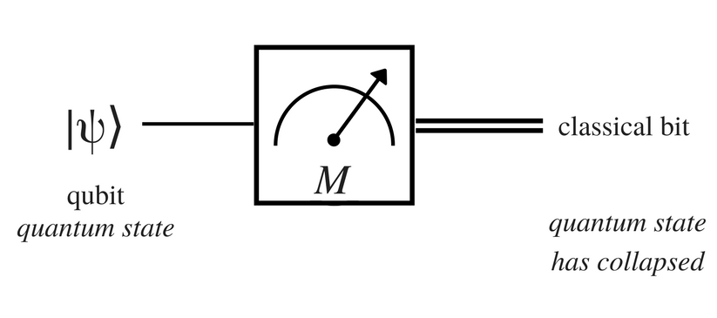
6. Measurement Devices
Quantum measurement is all about obtaining information about the state of a quantum system
Quantum Sensors, Quantum Microscopes, Quantum Clocks and Frequency Standards, Quantum Gravimeters and Gyroscopes.

Slide 26
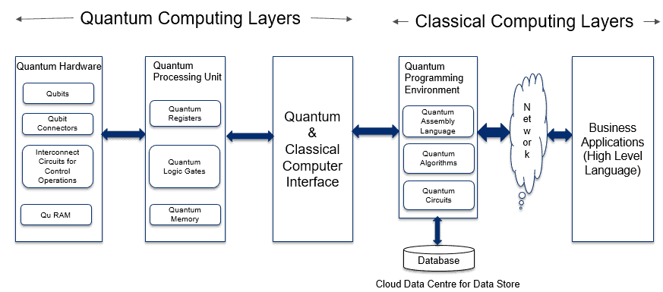
3.3 Architecture of Quantum Computer
1. Application Layer 2. Classical Processing Layer 3. Quantum Computing Layers
Source: Overview of Quantum Computer Platform (analyticsinsight.net)

Slide 27
Quantum Computer Cooling Systems
Quantum bits, or qubits, typically operate at extremely low temperatures to maintain their quantum states and minimize thermal noise.
The operational temperature for most superconducting qubits is around 10 to 20 milliKelvin (mK), which is just above absolute zero (approximately -273.15°C)
There are advancements in quantum technology that allow for operation at higher temperatures. For instance, silicon qubits have been shown to function at temperatures up to 10 Kelvin (K).

Slide 28
Quantum Computer Cooling Systems
Cooling System | Minimum Temperature Achievable | Type of Qubits
Dilution Refrigerator | ~10 mK (10 milliKelvin) | Superconducting qubits
Adiabatic Demagnetization Refrigeration (ADR) | < 2 K (2000 milliKelvin) | Various types of qubits
Pulse Tube Refrigeration (PTR) | < 4 K (4000 milliKelvin) | Superconducting qubits
Laser Cooling | Near absolute zero | Trapped ions, atomic qubits
2D Quantum Cooling System | 100 mK (100 milliKelvin) | Various types of qubits
Immersion Cooling with Helium-3 | < 1 K (1000 milliKelvin) | Superconducting qubits

Slide 29
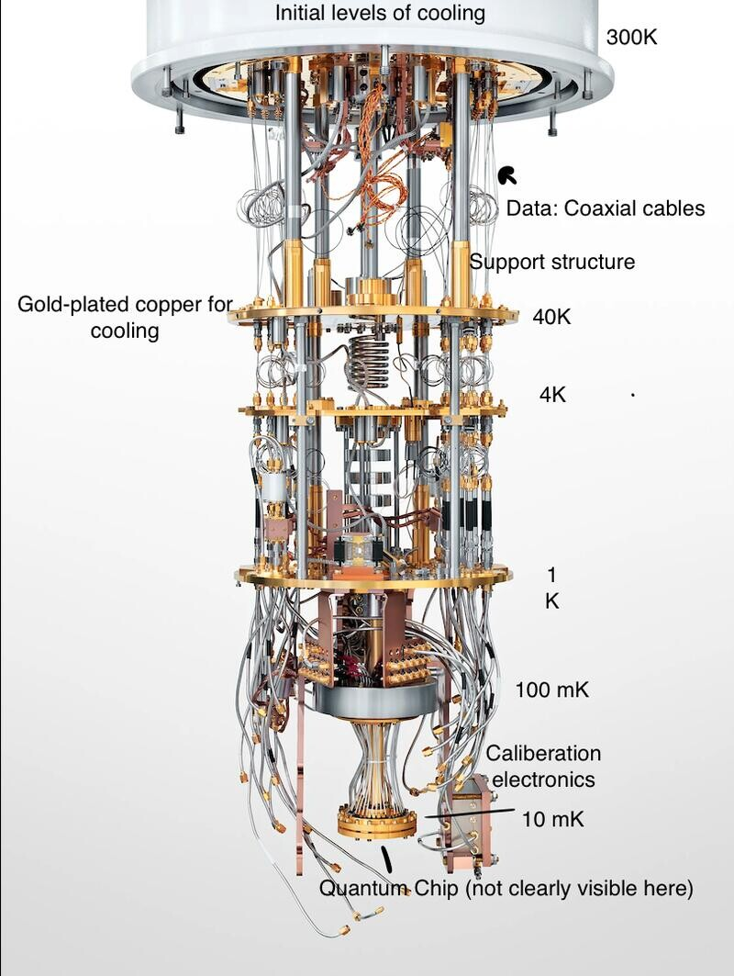
Source: (4) Quantum Computing 1: Breaking down the process | LinkedIn

Slide 30
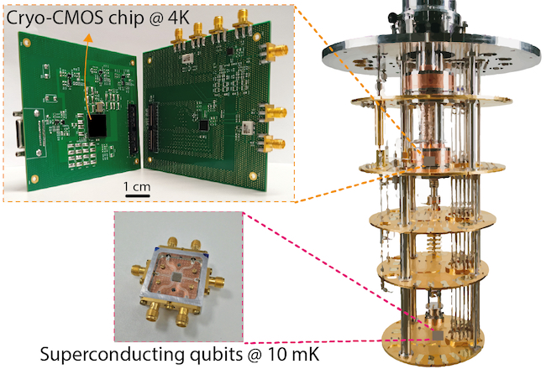
Image Source: University of Glasgow - University news - Archive of news - 2021 - November - UofG lends support to £6.5m quantum computing consortium

Slide 31
Quiz 1

Slide 32
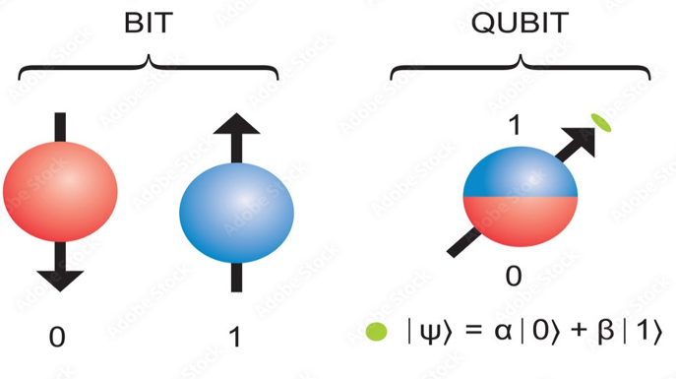
2. Qubit: Topics
1.Qubits and States
2.Representation of Qubits :
State Vectors
Dirac Notation : Basic Elements
Representing General Qubit States
Common Qubit states
Measurement in Qubit Notation
3. Inner Product and Outer Product
4. Perpendicular and Parallel Qubit Vectors
5. Magnitude and Normalization of the Qubit Vector
6. Angle between two Qubit vector using Dot Product
7. Linear Combination of two qubit vectors
8. Superposition of Qubits
9. Hilbert Space
10. Basis
11. Tensor Products
12. Entanglement of Qubits in Hilbert Space
13. Bell State
14. Complex numbers in Polar Form
15. Representing Qubits states in Bloch Sphere
A qubit, or quantum bit, is the fundamental unit of information in quantum computing, analogous to a classical bit in traditional computing.

Slide 33
N-qubit | Number of states | States | Examples
1 | 2^1 = 2 | |0⟩ and |1⟩ | A single qubit can be used as a highly sensitive quantum sensor to measure magnetic fields, electric fields, temperature, pressure and other quantities with extremely high precision
2 | 2^2 = 4 | 00⟩, |01⟩, |10⟩, and |11⟩ | Used to create entangled states, such as the Bell state 1/sqrt(2)*(∣00⟩+∣11⟩).
3 | 2^3 = 8 | |000⟩, |001⟩, |010⟩, |011⟩, |100⟩, |101⟩, |110⟩, and |111⟩ | A 3-qubit quantum computer can be used to simulate the behavior of a simple molecule like hydrogen (H2)
4 | 2^4 = 16 | |0000⟩, |0001⟩, |0010⟩, |0011⟩, |0100⟩, |0101⟩, |0110⟩, |0111⟩, |1000⟩, |1001⟩, |1010⟩, |1011⟩, |1100⟩, |1101⟩, |1110⟩, and |1111⟩. | A 4-qubit computer can be used to implement Grover's algorithm, which searches an unsorted database
8 | 2^8 = 256 |  | An 8-qubit quantum computer can be used to factor large numbers using Shor's algorithm,
30 | 2^30 = 1 billion |  | Could be used to simulate the behavior of complex molecules and materials, which is crucial for developing new drugs, batteries, and other technologies

Slide 34
Classical 2-Bit Example:
In classical computing, two bits can represent four distinct states:
00, 01, 10, and 11 whose binary values are 0,1,2 and 3.
Each bit is either 0 or 1.
Each state represents a unique combination of the two bits, corresponding to a specific decimal value from 0 to 3.
The system can only be in one of these states at a time.

Slide 35
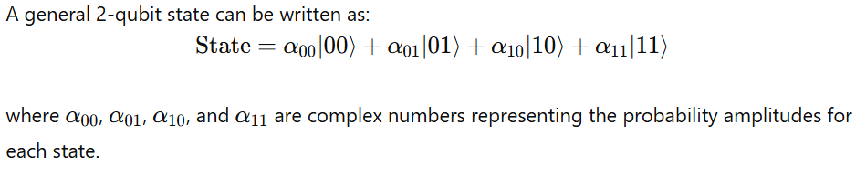
Quantum 2-Qubit System:
In quantum computing, two qubits can represent a superposition of all four states (00, 01, 10, and 11) simultaneously.
The state of the qubits is described as a linear combination of these basis states.

Slide 36
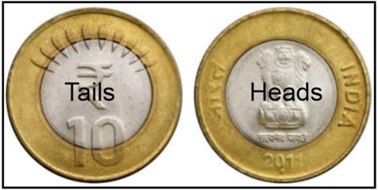
2.2 Representation of Qubits
State Vector : Each element in the state vector represents probability of being in that particular state.
State vector = [ H T]
If the coin is in the head’s state , state vector = [1 0]
If the coin is in the tail’s state , state vector = [0 1]
State vector is used to represent the state of quantum systems

Slide 37
Dirac Notation
Dirac notation, also known as bra-ket notation, is a standard way to represent quantum states and operations in quantum mechanics. It is particularly useful in describing qubits and quantum systems.
Ket ∣ψ⟩ : Column Vector
Bra ⟨ψ∣ : Row Vector
Bra-Ket : ⟨ψ∣ ψ⟩ Inner Product
Ket- Bra: ∣ψ⟩ ⟨ψ∣ Outer Product

Slide 38
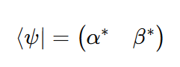
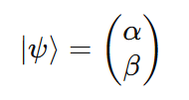
Basic Elements of Dirac Notation
Ket |ψ⟩:
Represents a column vector (a quantum state).
Bra ⟨ψ|: Represents the conjugate transpose (row vector) of the ket.
where α∗ and β∗ are the complex conjugates of α and β.

Slide 39
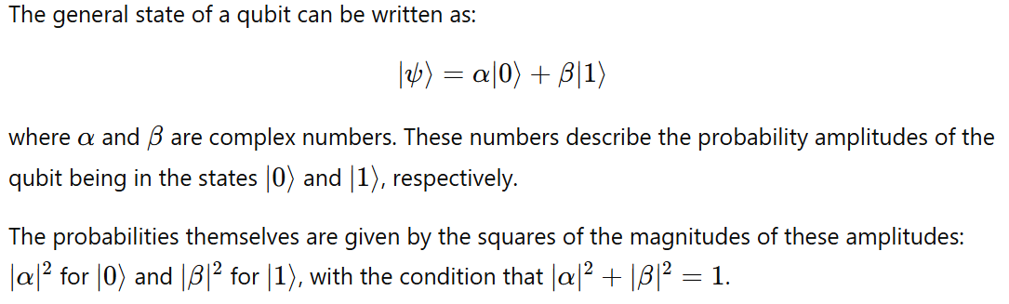
Qubit States

Slide 40
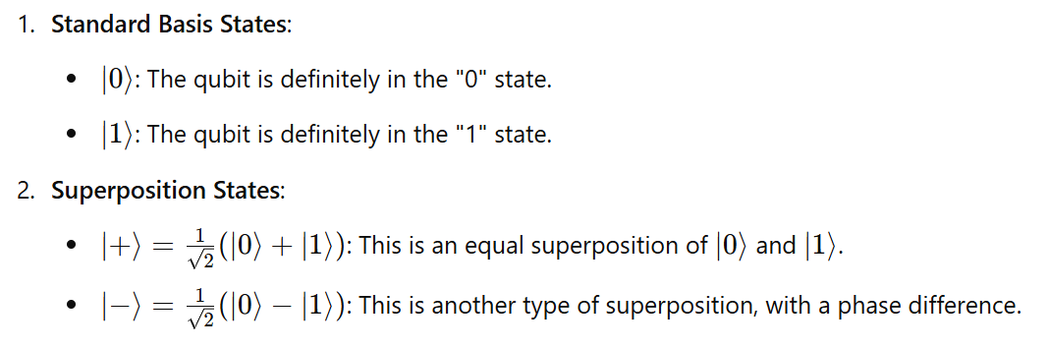
Common Qubit States

Slide 41
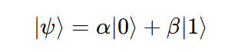
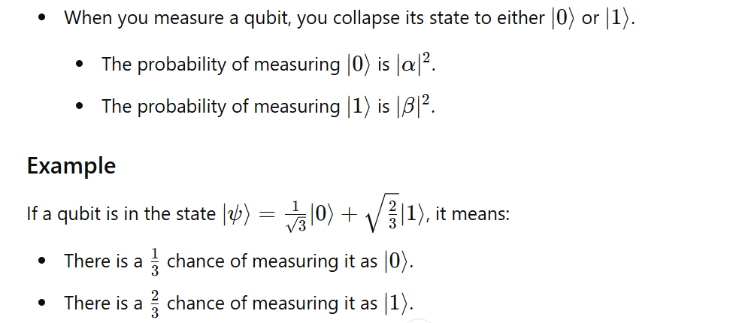
Measurement in Qubit Notation

Slide 42
2.3 Inner Product and Outer Product

Slide 43
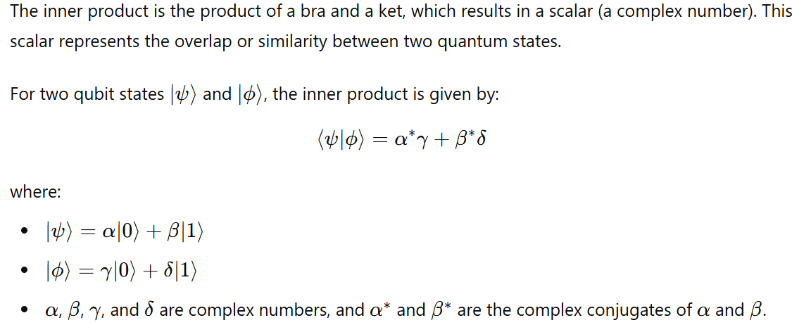
Bra-Ket: Inner Product (⟨ψ|ϕ⟩)

Slide 44
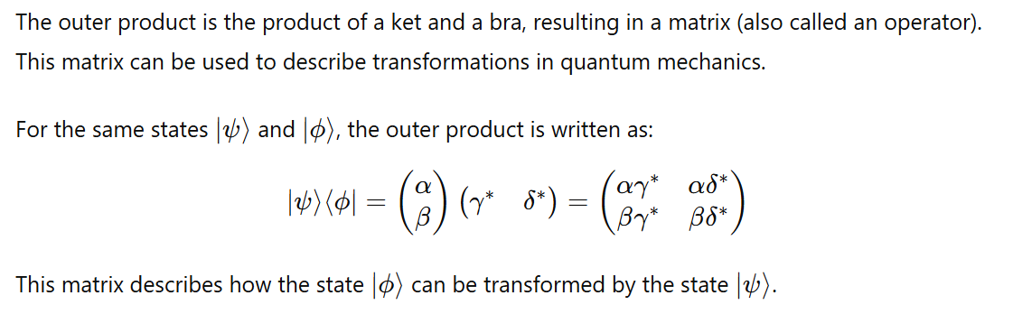
Ket-Bra: Outer Product (|ψ⟩⟨ϕ|)

Slide 45
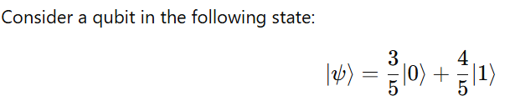

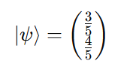
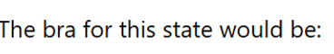
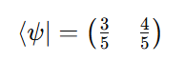
Inner Product Example

Slide 46
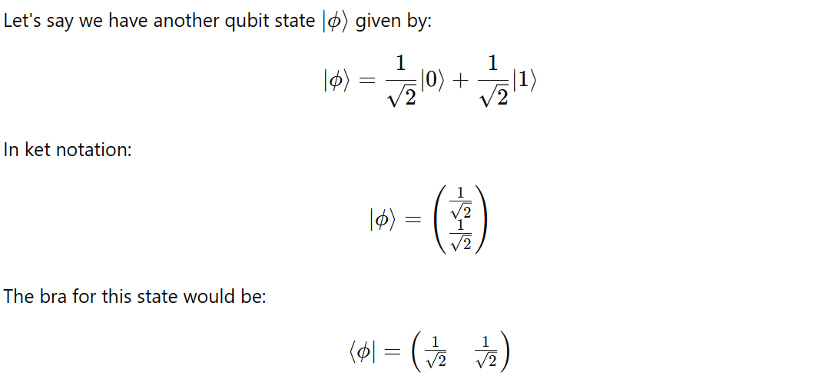
Inner Product Example

Slide 47
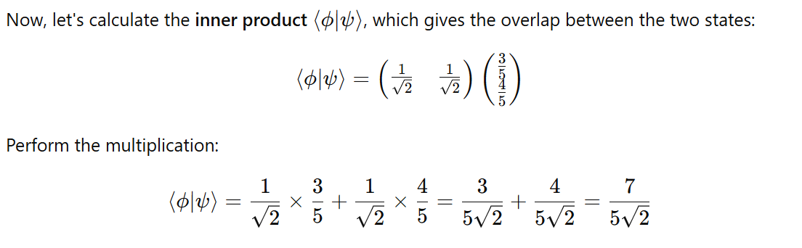
Inner Product Example

Slide 48
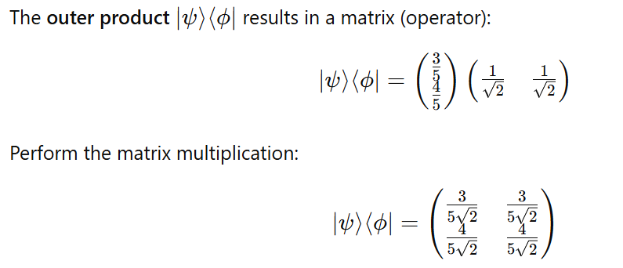
Outer Product Example

Slide 49
2.4 Perpendicular and Parallel Qubit Vectors

Slide 50
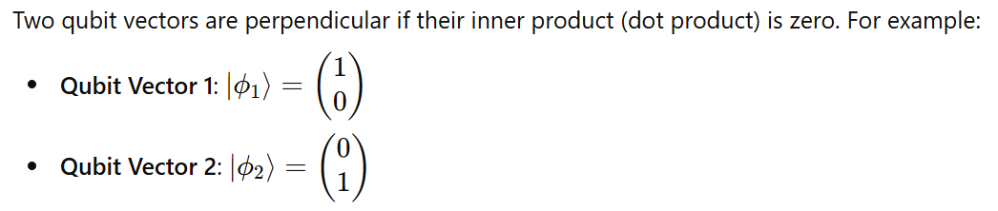
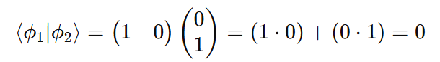
Perpendicular Qubit Vectors

Slide 51
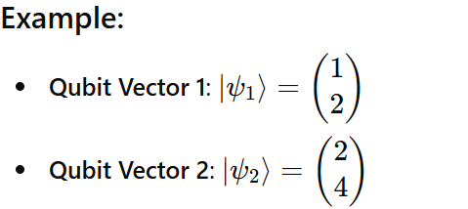
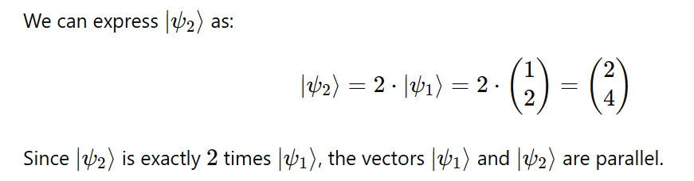
Two Parallel Qubit Vectors

Slide 52
2.5 Magnitude and Normalization of the Qubit Vector

Slide 53
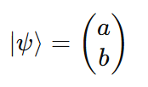
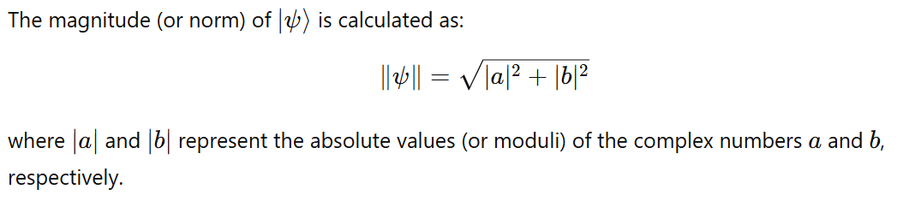
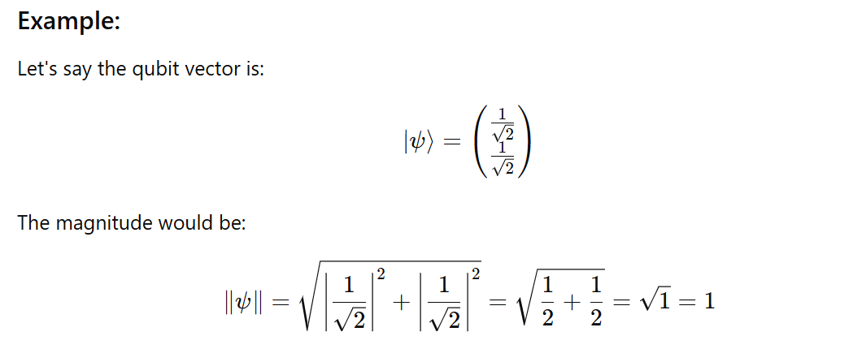
Magnitude of the Qubit Vector

Slide 54
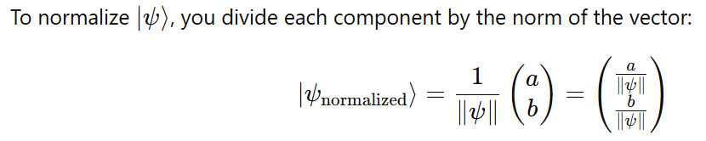
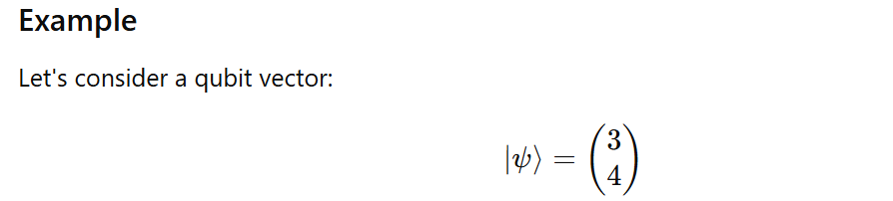
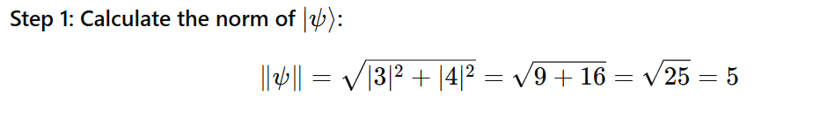
Normalization Process

Slide 55
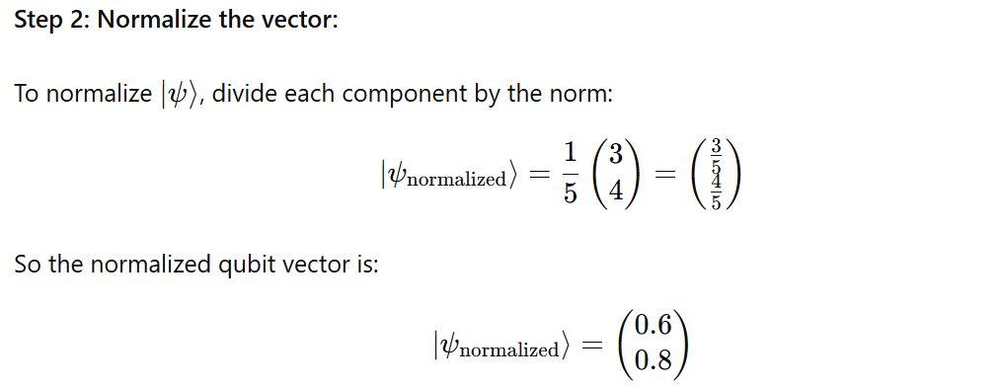
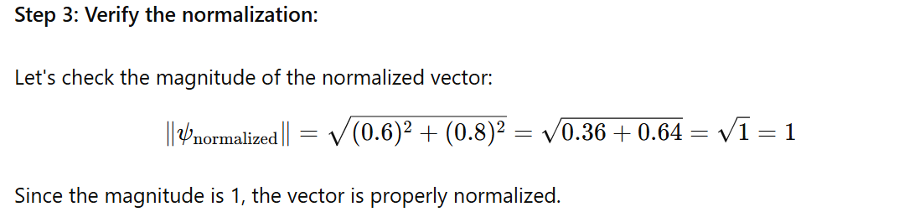
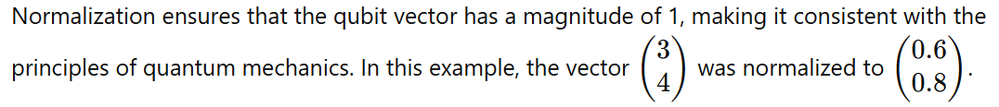

Slide 56
2.6 Angle between two Qubit vector using Dot Product

Slide 57
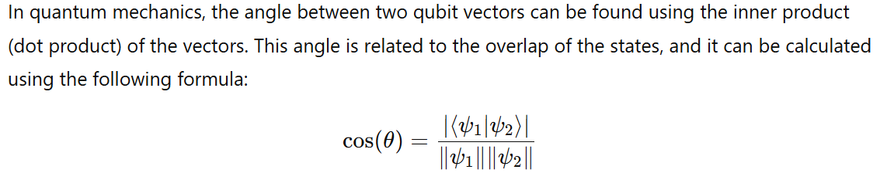
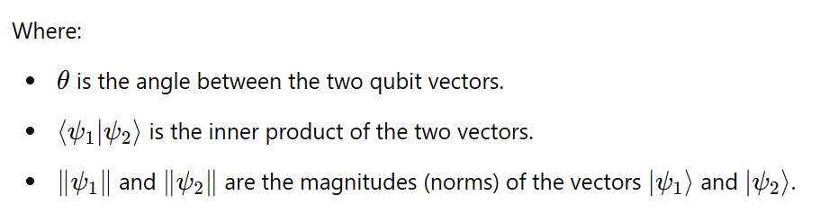
Finding the Angle Between Two Qubit Vectors Using the Dot Product

Slide 58
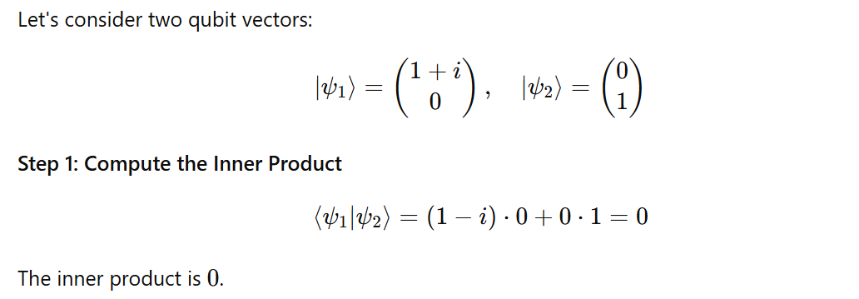
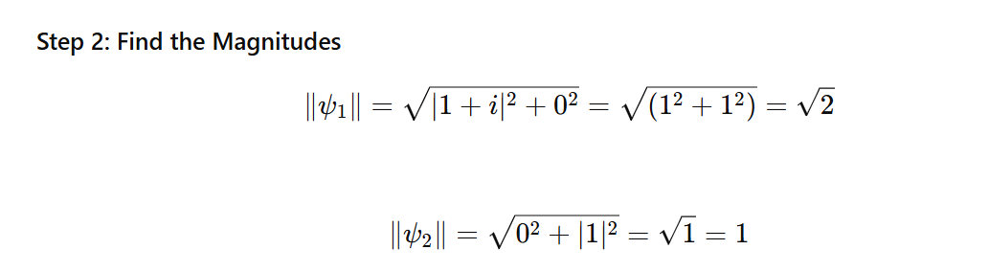
Example

Slide 59
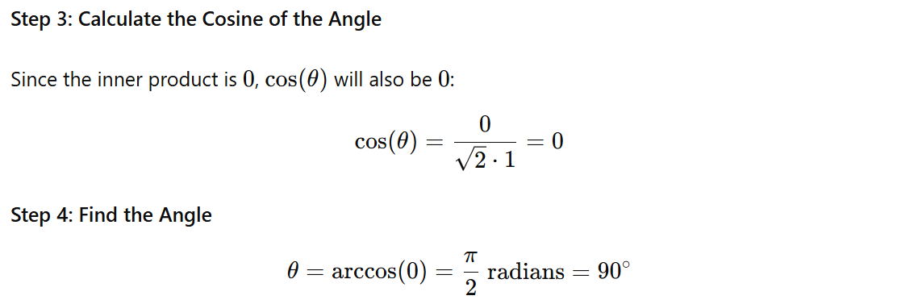
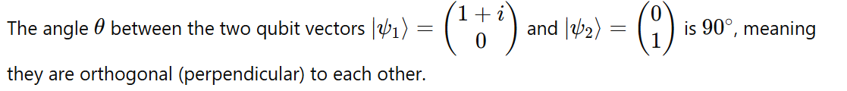

Slide 60

2.7 Linear Combination of Two Qubit Vectors
A linear combination of two qubit vectors involves creating a new qubit vector by adding the vectors together, each multiplied by a scalar (which can be a complex number).

Slide 61

Example

Slide 62

2.7 Superposition of Qubits

Slide 63

1. Equal Superposition

Slide 64

2. Biased Towards ∣0⟩

Slide 65

3. Biased Towards ∣1⟩

Slide 66

4. Closer to ∣0⟩

Slide 67

5. Very Close to ∣1⟩

Slide 68
Note
Ket notation ∣𝜓⟩: Represents the state as a column vector.
Bra notation ⟨𝜓∣: Represents the conjugate transpose of the ket as a row vector.
Inner product ⟨𝜙∣𝜓⟩: Gives a scalar, indicating the overlap between two quantum states.
Outer product ∣𝜓⟩⟨𝜙∣: Results in a matrix, useful for constructing quantum operators.

Slide 69
2.9 Hilbert Space in Quantum Computing
A Hilbert space in quantum computing is a mathematical framework used to describe the state space of quantum systems. It is a complete inner product space where:
Vectors represent quantum states.
Inner product defines the overlap or similarity between states.
Norm of a vector represents the probability amplitude of finding the system in that state.
Unitary Operators represent quantum gates.
Projection Operators represent measurements.
Probabilities are calculated based on the norms and inner products.

Slide 70

Hilbert Space in Quantum Computing

Slide 71
2.10 Basis in Quantum Mechanics
In quantum mechanics, a basis typically refers to a set of orthonormal vectors in a Hilbert space.
For qubits, the basis vectors are often represented as ∣0⟩ and ∣1⟩, which are the standard basis vectors for a single qubit

Slide 72

|0> and |1> are ortho normal basis

Slide 73

|0> and |1> are ortho normal basis

Slide 74
2.11 Tensor Products
If we have two vector spaces V and W, their tensor product of V and W is a new vector space formed from all possible combinations of vectors from V and W.
The dimension of the tensor product space is the product of the dimensions of the individual spaces.
For example, if V has dimension m and W has dimension n, then tensor product of V and W has dimension m×n.

Slide 75

Tensor Product Notation

Slide 76

Example 1 :

Slide 77

Example 2:

Slide 78

Example 3:

Slide 79


Example 4:

Slide 80




Example 5:

Slide 81
2.12 Entanglement of Qubits in Hilbert Space
Entanglement is a quantum phenomenon where two or more qubits become linked in such a way that the state of one qubit is dependent on the state of the other, no matter the distance between them.
This relationship persists even if the qubits are separated by large distances, leading to correlations in their measurements.
In quantum computing, entangled states are described using the Hilbert space of multiple qubits.
Entanglement involves quantum states that cannot be factored into separate states of individual qubits:

Slide 82

Entanglement of Qubits in Hilbert Space
Entanglement is a quantum phenomenon where two or more qubits become linked in such a way that the state of one qubit is dependent on the state of the other, no matter the distance between them.
Entanglement involves quantum states that cannot be factored into separate states of individual qubits.
Example :

Slide 83
2.13 What is Bell State?
The Bell states are specific quantum states of two qubits that are maximally entangled.
They are named after physicist John Bell, who studied the implications of entanglement for quantum mechanics and classical physics.
There are four Bell states, each representing a different kind of entanglement between the two qubits.

Slide 84


Slide 85


Slide 86


Slide 87


Slide 88


Prove that The Bell State is entangled state

Slide 89





Slide 90



Slide 91



Slide 92


2.14 Complex Numbers in Polar Form

Slide 93


2.15 Representing QuBits states using Bloch Sphere
The state of a qubit can be represented as a point on the Bloch Sphere
It is a unit sphere, where r=1.

Slide 94



Slide 95




Slide 96
Representing QuBits states using Bloch Sphere
A Bloch sphere uses its three axes to represent a qubit’s state. The state vector originates in the center of the sphere and terminates at a point with z, x, and y coordinates.
The z-axis represents the probability of the qubit being measured as a 0 or a 1.
The x-axis represents the real part of the state vector.
The y-axis represents the imaginary part of the state vector.

Slide 97

Qubit State in Polar Coordinates

Slide 98




Slide 99









Slide 100







Slide 101
Quiz 2

Slide 102
Open Source SDKs for Quantum Computing
There are several open-source SDKs (Software Development Kits) available for quantum computing, each designed to help developers and researchers build, test, and run quantum algorithms on various quantum hardware and simulators.

Slide 103
Open Source SDKs for Quantum Computing
Sl.NO | SDK | Developer | Language
1 | Qiskit | IBM Research and the Qiskit community. | Python
2 | Cirq | Google | Python
3 | Braket | Amazon | Python
4 | Forest | Rigetti Computing | Python
5 | Ocean | D-Wave Systems. | Python
6 | ProjectQ | ETH Zurich | Python
7 | QDK | Microsoft | Q#
Others : Strawberry Fields (Xanadu)(Python), Quipper (Haskel), PennyLane(Python),etc.

Slide 104
Qiskit Key Features
Components: Includes
Terra[ Earth] : circuit construction
Aer [ Air] : simulation,
Ignis [Fire ] : error mitigation, and
Aqua [Water] : application-specific algorithms.
Ecosystem: Supports a wide range of quantum algorithms and applications, including finance, chemistry, and machine learning.
Community: Strong community support with extensive tutorials and resources.
Use Cases: Suitable for both beginners and advanced users, enabling access to IBM's quantum hardware and simulators.

Slide 105
Installing Qiskit
pip install qiskit
[ This This will install the latest stable version of Qiskit, including: Qiskit Terra, Qiskit Aer, Qiskit Ignis and Qiskit Aqua]
Upgrading qistkit: pip install --upgrade qiskit
Installing Individual Components
pip install qiskit-terra
pip install qiskit-aer
pip install qiskit-ignis
pip install qiskit-aqua

Slide 106

Verifying the Installation

Slide 107

Verifying the Installation

Slide 108
Qiskit Python Programs to representing Single Qubit States
|0⟩ state
|1⟩ state
|i⟩ state
|-i⟩ state
|+⟩ state
|-⟩ state

Slide 109


1. Qiskit Python program to represent the |0⟩ state vector

Slide 111



Slide 112



Slide 113



Slide 114



Slide 115



Slide 116
Quiz 3

Slide 117
Quantum Gates and Quantum Circuits
Dr. Thyagaraju G S
Professor and HoD, Department of CSE,
SDM Institute Of Technology, Ujire-574240

Slide 118

Unitary Operations

Slide 119
1. Quantum Gates
Pauli Gates (X, Y, Z)
Hadamard Gate (H)
Phase Gates (S, T)
Controlled Gates(CX,XZ)
Swap Gate
Toffoli Gate (CCNOT)
Fredkin Gate (CSWAP)
Identity Gate (I)
Rotation Gates (Rx, Ry, Rz)

Slide 120


1.1.1 Pauli X Gate

Slide 121

Pauli X Gate

Slide 122


1.1.2 Y Gate (Pauli-Y)

Slide 123


1.1.3 Z Gate (Pauli-Z)

Slide 124



1.2 Hadamard Gate (H)

Slide 125

1.3.1 S Gate (Phase Gate)

Slide 126

1.3.2 T Gate (Phase Gate)

Slide 127


Note

Slide 128




Slide 129



1.4.1 CNOT Gate (Controlled-X)
The Controlled-NOT (CNOT) gate, also known as the Controlled-X gate, is a two-qubit gate that flips the state of the target qubit if the control qubit is in the state ∣1>

Slide 130


CNOT Gate Matrix Representation

Slide 131




Slide 132

1.4.2 Controlled-Z Gate (CZ)
The Controlled-Z (CZ) gate is a two-qubit quantum gate that applies a Z gate (also known as a phase-flip gate) to the second qubit, but only if the first qubit (the control qubit) is in the state ∣1⟩|1\rangle∣1⟩. Otherwise, it leaves both qubits unchanged.

Slide 133


Applying the CZ Gate to Basis States

Slide 134


Applying the CZ Gate to Basis States

Slide 135

1.5 Swap Gate

Slide 136


Applying the Swap Gate to Basis States

Slide 137



Slide 138

1.6 Toffoli Gate (CCNOT)

Slide 139



The Toffoli gate performs the following operation on the computational basis states:
The target qubit (third qubit) is flipped only when both control qubits (first and second qubits) are ∣1⟩.

Slide 140

State Vector ∣110⟩:
The state ∣110⟩ corresponds to the following column vector (indexing from 0):

Slide 141


Slide 142

1.7 Identity Gate (I)

Slide 143

1.8.1 Rx Gate

Slide 144


The Rx gate is a single-qubit rotation gate that rotates the state of a qubit around the X-axis of the Bloch sphere

Slide 145


Example 1: Rx Gate on ∣0⟩

Slide 146


Example 2: Rx Gate on ∣1⟩

Slide 147

1.8.2 Ry Gate

Slide 148

1.8.3 Rz Gate

Slide 149

Single-qubit gates are generally shown as squares with a letter indicating which operation it is, like this:

Slide 150

Not gates (also known as X gates) are also sometimes denoted by a circle around a plus sign:

Slide 151

Swap gates are denoted as follows:

Slide 152

Controlled-gates, meaning gates that describe controlled-unitary operations, are denoted by a filled-in circle (indicating the control) connected by a vertical line to whatever operation is being controlled. For instance, controlled-NOT gates, controlled-controlled-NOT (or Toffoli) gates, and controlled-swap (Fredkin) gates are denoted like this:

Slide 153

Arbitrary unitary operations on multiple qubits may be viewed as gates. They are depicted by rectangles labeled by the name of the unitary operation. For instance, here is a depiction of an (unspecified) unitary operation U as a gate, along with a controlled version of this gate:

Slide 154
Basic Structure of a Quantum Circuit
A quantum circuit typically consists of:
Qubits: The basic unit of quantum information, analogous to bits in classical computing. Qubits can exist in superposition states.
Quantum Gates: Operations that change the state of qubits.
Single-qubit gates (e.g., Hadamard, Pauli-X, Y, Z)
Multi-qubit gates (e.g., CNOT, SWAP)
Measurement: The final step in a quantum circuit, where the qubits are measured to produce a classical output. The process of observing qubit states, collapsing superpositions.
Circuit diagram: A visual representation of qubit operations over time.
Initialization: Setting qubits to known starting states.
Quantum register: A collection of qubits used in the circuit.
Classical register: Stores measurement results for further processing.

Slide 155

Ex1

Slide 156

Ex2

Slide 157

Ex3:

Slide 158

Ex4:

Slide 159

Ex5:

Slide 160

Ex6:

Slide 161

Ex7:

Slide 162

If we wish to choose our own name we can do this using the Quantum Register class like this:

Slide 163


Program to create a new circuit with two new qubits, then displays the circuit's qubits attribute

Slide 164


Slide 165



Slide 166



Slide 167



Slide 168


Slide 169



Circuit with Hadmard and Control Gate

Slide 170
Types
Quantum circuits can be categorized based on their functionality and the types of operations they perform.
Here are some simple types of quantum circuits:

Slide 171
1. Basic Quantum Circuits
These circuits perform simple quantum operations such as initializing qubits, applying single-qubit gates, and measuring the output.
Example: Basic Quantum Circuit
Circuit: Apply a Hadamard gate to a single qubit, then measure the result.
Operation: This circuit creates a superposition state

Slide 172


Slide 173




Slide 174
2. Entanglement Circuits
These circuits involve creating entangled states between two or more qubits, where the state of one qubit is dependent on the state of another. The most common example is the Bell state.
Example: Entanglement Circuit
Circuit: Apply a Hadamard gate to the first qubit and a CNOT gate to entangle it with the second qubit.
Operation: This circuit creates an entangled Bell state.

Slide 175

Another example of a quantum circuit, this time with two qubits
As always, the gate labeled H refers to a Hadamard operation, while the second gate is a two-qubit gate: it's the controlled-NOT operation, where the solid circle represents the control qubit and the circle resembling the symbol ⊕ denotes the target qubit.

Slide 176
Another example of a quantum circuit, this time with two qubits
Above circuit describes an operation on a pair of qubits (X,Y) — and if the input to the circuit is a quantum state ∣ψ⟩∣ϕ⟩, then this means that the lower qubit X starts in the state ∣ψ⟩ and the upper qubit Y starts in the state ∣ϕ⟩.

Slide 177

The first operation is a Hadamard operation on Y:
When applying a gate to a single qubit like this, nothing happens to the other qubits — and nothing happening is equivalent to the identity operation being performed.

Slide 178


The first operation is a Hadamard operation on Y:
In our circuit there is just one other qubit, X, so the dotted rectangle in the figure above represents this operation:
Note that the identity matrix is on the left of the tensor product and H is on the right, which is consistent with Qiskit's ordering convention.

Slide 179

The second operation is the controlled-NOT operation, where Y is the control and X is the target:

Slide 180

The controlled-NOT gate's action on standard basis states is as follows:

Slide 181


Given that we order the qubits as (X,Y), the matrix representation of the controlled-NOT gate is this:
The unitary operation of the entire circuit, which we'll call U,U, is the composition of the operations:

Slide 182

In particular, recalling our notation for the Bell states,

Slide 183

We get

Slide 184

In general, quantum circuits can contain any number of qubit wires. We may also include classical bit wires, which are indicated by double lines like in this example:

Slide 185
Sometimes it is convenient to depict a measurement as a gate that takes a qubit as input and outputs a classical bit (as opposed to outputting the qubit in its post-measurement state and writing the result to a separate classical bit). This means the measured qubit has been discarded and can safely be ignored thereafter.

Slide 186

For example, the following circuit diagram represents the same process as the one in the previous diagram, but where we ignore X and Y after measuring them:

Slide 187


Slide 188




Slide 189
Quiz 4

Slide 190
Introduction to Quantum Algorithms
Dr. Thyagaraju G S
Professor and HoD, Department of CSE,
SDM Institute Of Technology, Ujire-574240

Slide 191
Quantum Algorithms
Quantum algorithms are procedures that run on quantum computers and take advantage of quantum mechanics' principles to solve problems more efficiently than classical algorithms.
These algorithms utilize the unique properties of quantum bits (qubits), such as superposition, entanglement, and interference, to perform computations that are infeasible or extremely slow on classical computers.

Slide 192
Types of Quantum Algorithms
Quantum Search Algorithms
Quantum Factoring Algorithms
Quantum Simulation Algorithms:
Quantum Optimization Algorithms
Quantum Machine Learning Algorithms:
Quantum Fourier Transform (QFT)
Quantum Cryptography Algorithms

Slide 193
2. Quantum Factoring Algorithms:
Shor's Algorithm: This algorithm can factor large integers exponentially faster than the best-known classical algorithms. It's particularly significant because it could potentially break widely used cryptographic systems like RSA, which relies on the difficulty of factoring large numbers.

Slide 194
3. Quantum Simulation Algorithms:
Quantum Simulations: Quantum computers can simulate quantum systems much more efficiently than classical computers. Algorithms in this category are used to model molecular structures, chemical reactions, and other quantum systems, which has applications in materials science, chemistry, and drug discovery.

Slide 195
4. Quantum Optimization Algorithms:
Quantum Approximate Optimization Algorithm (QAOA): This algorithm is used to solve combinatorial optimization problems by finding approximate solutions more efficiently than classical methods.
Variational Quantum Eigensolver (VQE): VQE is used to find the ground state energy of a quantum system, which is crucial in quantum chemistry.

Slide 196
5. Quantum Machine Learning Algorithms
Quantum Support Vector Machine (QSVM): An adaptation of classical support vector machines, QSVMs leverage quantum computing to classify data points more efficiently.
Quantum Neural Networks (QNNs): These networks combine quantum computing with the principles of neural networks to potentially outperform classical neural networks in certain tasks.

Slide 197
6. Quantum Fourier Transform (QFT):
QFT is a quantum version of the discrete Fourier transform and is a crucial component of several quantum algorithms, including Shor's algorithm. It is used for transforming quantum states into their frequency components, which is essential in solving problems related to periodicity and number theory.

Slide 198
7. Quantum Cryptography Algorithms:
Quantum Key Distribution (QKD): QKD uses quantum mechanics to create secure communication channels, ensuring that any eavesdropping attempts can be detected. The most famous QKD protocol is BB84.

Slide 199
1. Quantum Search Algorithms:
Grover's Algorithm: One of the most famous quantum algorithms, Grover's algorithm provides a quadratic speedup for unstructured search problems.
For example, if a classical algorithm needs N steps to search a list of N items, Grover's algorithm can do it in sqrt(N)​ steps.

Slide 200

Grover’s Algorithm
Grover's algorithm is a quantum algorithm that provides a significant speedup for searching an unsorted database or solving unstructured search problems. It is particularly known for its quadratic speedup compared to classical algorithms.

Slide 201


Steps of Grover's Algorithm

Slide 202


Steps of Grover's Algorithm

Slide 203
Example: Searching a Database
Here's an implementation of Grover's Algorithm using Qiskit to search for a marked state in an unsorted database.
The example circuit is designed to find the state |11⟩ out of the four possible states |00⟩, |01⟩, |10⟩, and |11⟩ using Grover's algorithm.

Slide 204


Slide 205


Slide 206


Slide 207



Slide 208
Quiz 5

Slide 209
Future Directions and Research Opportunities in Quantum Computing
Dr. Thyagaraju G S
Professor and HoD, Department of CSE,
SDM Institute Of Technology, Ujire-574240

Slide 210
Key areas
Quantum Algorithms
Quantum Error Correction
Quantum Hardware Development
Quantum Communication and Cryptography
Quantum Simulation
Quantum Machine Learning
Topological Quantum Computing
Quantum Metrology and Sensing
Quantum Ethics and Governance
Quantum Education and Workforce Development

Slide 211
1. Quantum Algorithms
New Algorithms Development
Focus on optimization, machine learning, cryptography
Hybrid Classical-Quantum Algorithms
Benefits of combining classical and quantum computing

Slide 212
2. Quantum Error Correction
Improving Error Correction Codes
Importance of mitigating quantum noise
Fault-Tolerant Quantum Computing
Steps toward reliable quantum computation

Slide 213
3. Quantum Hardware Development
Scalability of Quantum Processors
Challenges and research focus
Exploring Qubit Technologies
Superconducting, trapped ions, topological qubits
Quantum Interconnects
Connecting multiple quantum processors

Slide 214
4. Quantum Communication and Cryptography
Quantum Internet
Secure long-distance communication
Quantum Key Distribution (QKD)
Integration with classical networks

Slide 215
5. Quantum Simulation
Simulating Complex Systems
Applications in materials science, chemistry, drug discovery
Digital vs. Analog Simulations
Comparison of approaches

Slide 216
6. Quantum Machine Learning
Quantum-enhanced Machine Learning
Advantages for large datasets, complex problems
Variational Quantum Algorithms
Optimization of machine learning models

Slide 217
7. Topological Quantum Computing
Topological Qubits
Error resistance and stability
Majorana Fermions
Research in creating protected qubits

Slide 218
8. Quantum Metrology and Sensing
High-Precision Measurements
Leveraging quantum properties for accuracy
Applications in Medicine and Environmental Science
Early disease detection, environmental monitoring

Slide 219
9. Quantum Ethics and Governance
Ethical Considerations
Privacy, cybersecurity, and societal impact
Policy and Regulation
Frameworks for responsible development

Slide 220
10. Quantum Education and Workforce Development
Expanding Educational Programs
Preparing the next generation of quantum experts
Interdisciplinary Research
Collaboration across physics, computer science, and engineering

Slide 221
Questions?

Slide 222
References
ChatGPT
Perplexity
Claude
Qiskit | IBM Quantum Computing
Qubits: What is a Qubit and How Qubits Work? - MAKB Tech (makb183.com)
Qubit (devopedia.org)
Cryogenic measurements of semiconductor devices - NPL

Slide 223
References
Google's Quantum Lab in California holds the future of computing (youtube.com)
Quantum Computers, explained with MKBHD (youtube.com)
The Map of Quantum Computing - Quantum Computing Explained (youtube.com)
Quantum Computing Hardware - An Introduction (youtube.com)
Decoded: How Does a Quantum Computer Work? (youtube.com)
Quantum Computing: Algorithm, Programming and Hardware, an Introduction (youtube.com)
Inside a Quantum Computer! with Andrea Morello (Part 1 of 2) (youtube.com)
L2-1 Quantum Computing Hardware: An Overview (youtube.com)
What Would a Quantum Internet Look Like? (youtube.com)

Slide 224
References
Mapping the qubit state onto the Bloch Sphere (youtube.com)
qiskit-tutorials/reference/tools/getting_started.ipynb at 66ab9961e5e25f8712819cd212351ee077a811ae · Qiskit/qiskit-tutorials · GitHub
qiskit-tutorials/reference/tools/quantum_gates_and_linear_algebra.ipynb at 66ab9961e5e25f8712819cd212351ee077a811ae · Qiskit/qiskit-tutorials · GitHub
textbook/notebooks/ch-states/single-qubit-gates.ipynb at main · Qiskit/textbook · GitHub
textbook/notebooks/ch-prerequisites at main · Qiskit/textbook · GitHub

Slide 225
Thank you

